Slide 1
Welcome

Slide 2
Why should developers care?

Slide 3
Why should developers care?
Faster

Slide 4
Why should developers care?
Faster
Reduce code

Slide 5
Theme
Style
Notes:
Styles and themes on Android allow you to separate the details of your app design from the UI structure and behavior, similar to stylesheets in web design.

Slide 6
Style for a specific view
Notes:
A style is a collection of attributes that specify the appearance for a single View
A style can specify attributes such as font color, font size, background color, and much more.

Slide 7
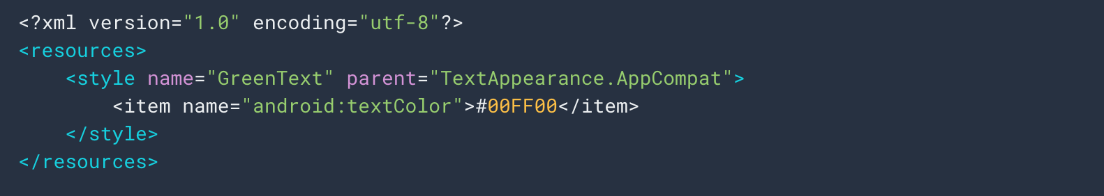
Notes:
A style is a collection of attributes that specify the appearance for a single View
A style can specify attributes such as font color, font size, background color, and much more.

Slide 8
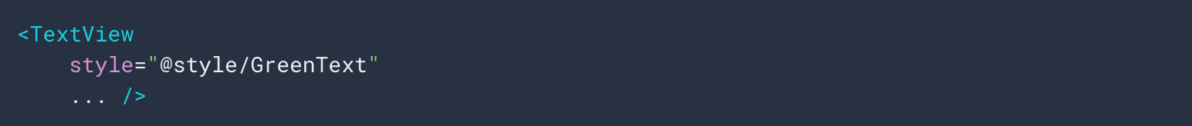
Notes:
A style is a collection of attributes that specify the appearance for a single View
A style can specify attributes such as font color, font size, background color, and much more.

Slide 9
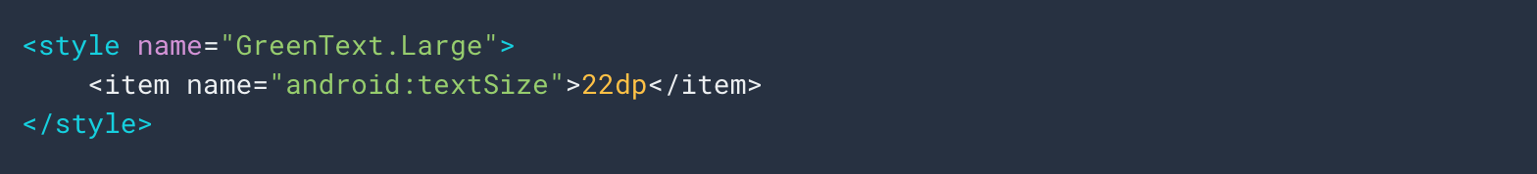
Notes:
A style is a collection of attributes that specify the appearance for a single View
A style can specify attributes such as font color, font size, background color, and much more.

Slide 10
Notes:
A style is a collection of attributes that specify the appearance for a single View
A style can specify attributes such as font color, font size, background color, and much more.

Slide 11
Notes:
A style is a collection of attributes that specify the appearance for a single View
A style can specify attributes such as font color, font size, background color, and much more.

Slide 12
Theme for an entire application

Slide 13
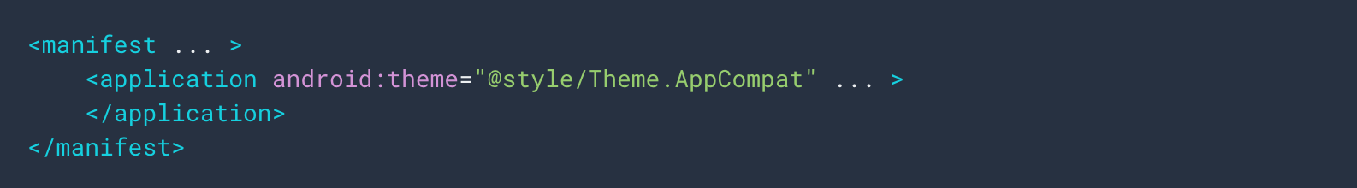

Slide 14
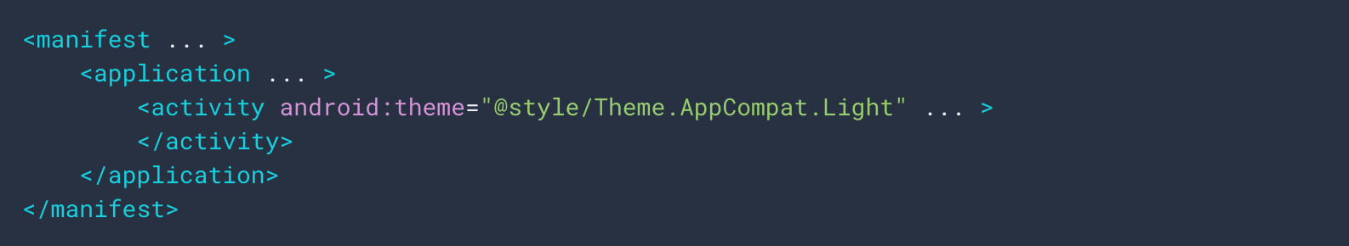

Slide 16
Material.io

Slide 20
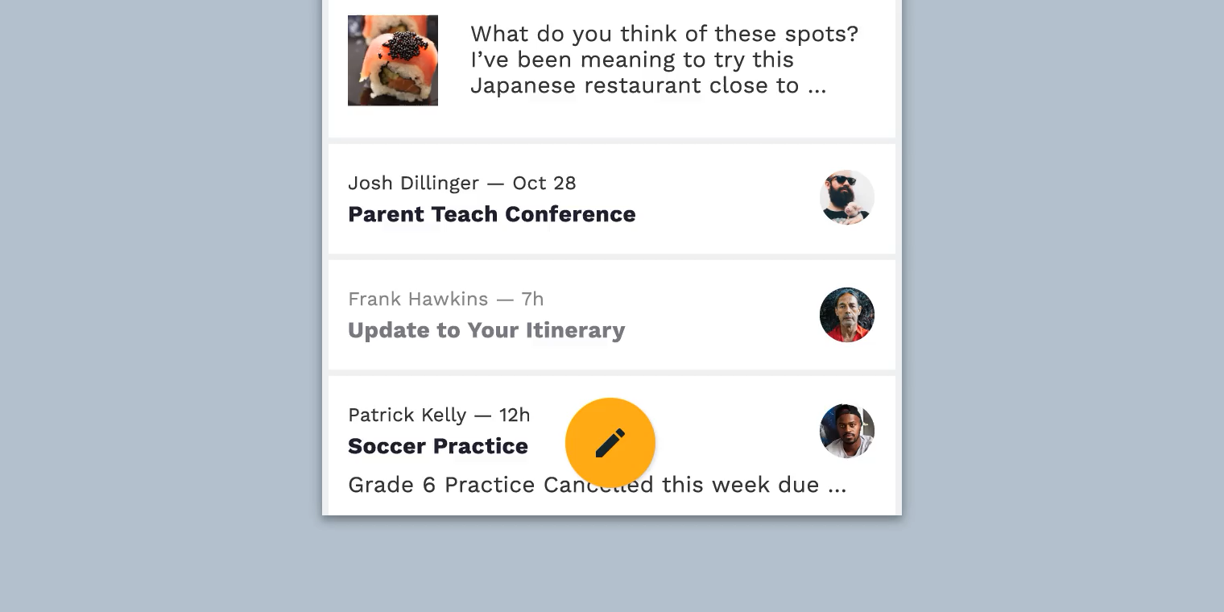

Slide 21
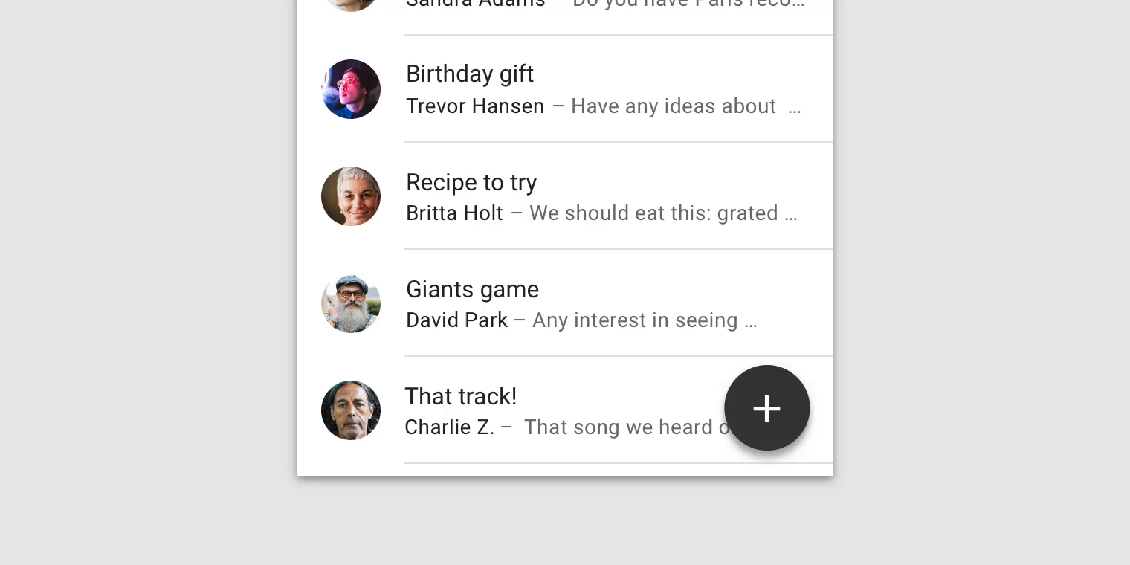


Slide 22
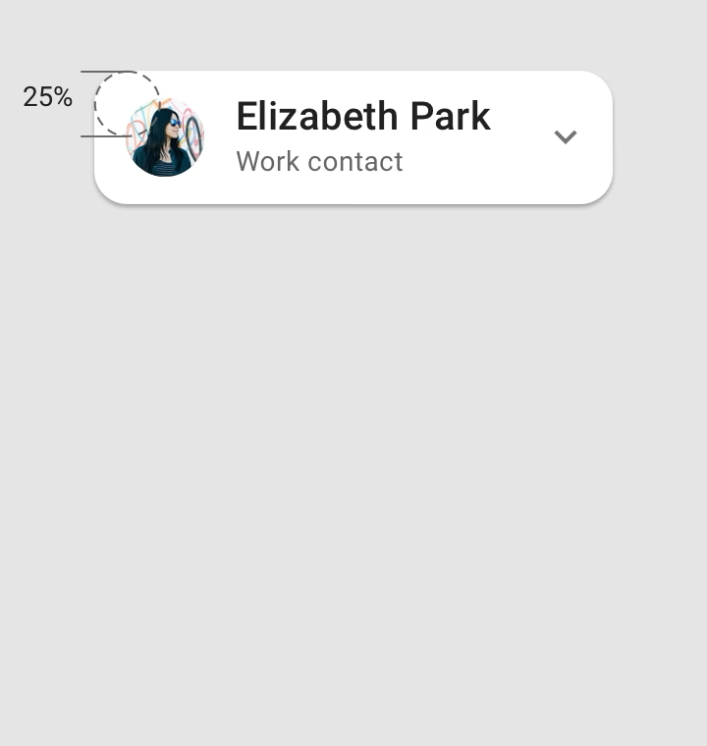
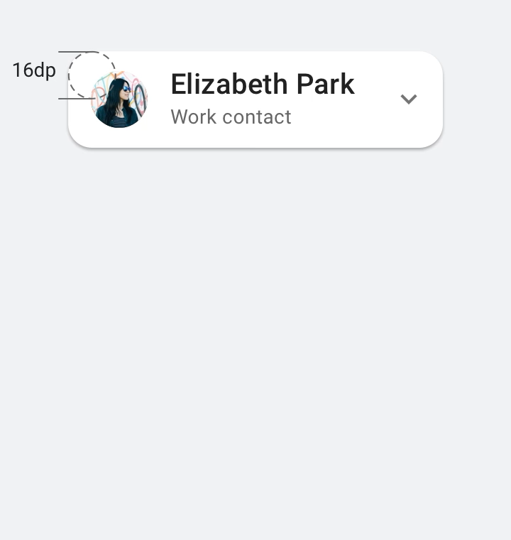

Slide 23
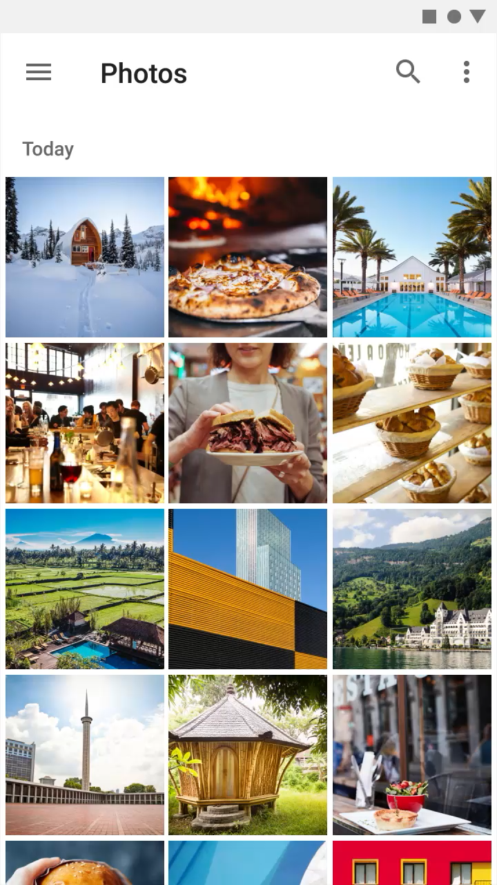
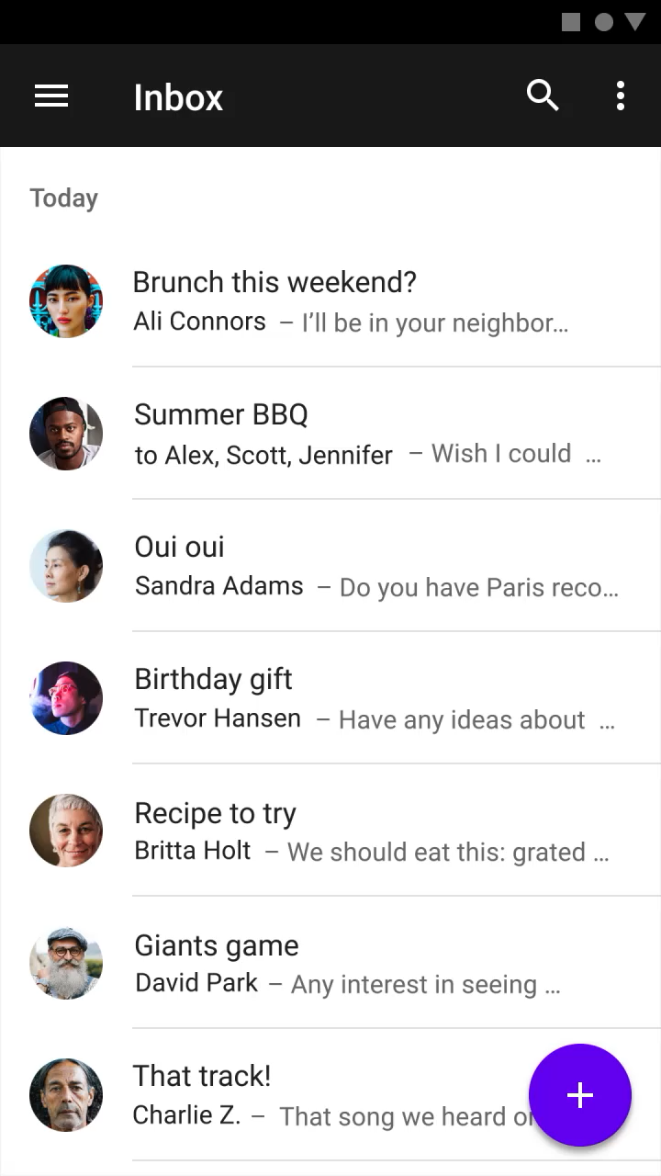

Slide 24
UX in Android

Slide 25
UX in Android
Drawables

Slide 26
UX in Android
Drawables
Styles

Slide 27
UX in Android
Drawables
Styles
Theme

Slide 28
Why do we should care?

Slide 29
Why do we should care?
Performance

Slide 30
Why do we should care?
Performance
Accuracy

Slide 31
Why do we should care?
Performance
Accuracy
Responsiveness

Slide 32
Vector
Bitmap

Slide 35
Bitmap files are a set of pixels in a grid
Vector graphics are describing the objects geometrically.
Notes:
(this means vector can scale with no loss of quality)

Slide 36
9-patch

Slide 37
Drawable

Slide 38
Drawable

Slide 39
Drawable
Generic class used to present any kind of graphic

Slide 40
Drawable
Generic class used to present any kind of graphic
Bitmap

Slide 41
Drawable
Generic class used to present any kind of graphic
Bitmap – Shape drawable

Slide 42
Drawable
Generic class used to present any kind of graphic
Bitmap – Shape drawable – Layer List

Slide 43
Drawable
Generic class used to present any kind of graphic
Bitmap – Shape drawable – Layer List
Vector drawable

Slide 44
Drawable
Generic class used to present any kind of graphic
Bitmap – Shape drawable – Layer List
Vector drawable – Transition drawable

Slide 45
Drawable
Generic class used to present any kind of graphic
Bitmap – Shape drawable – Layer List
Vector drawable – Transition drawable
And more…

Slide 46
Image asset Studio
Notes:
Helps you to build multiple versions of each bitmap for different disparate resolutions.
Create your own app icon

Slide 47
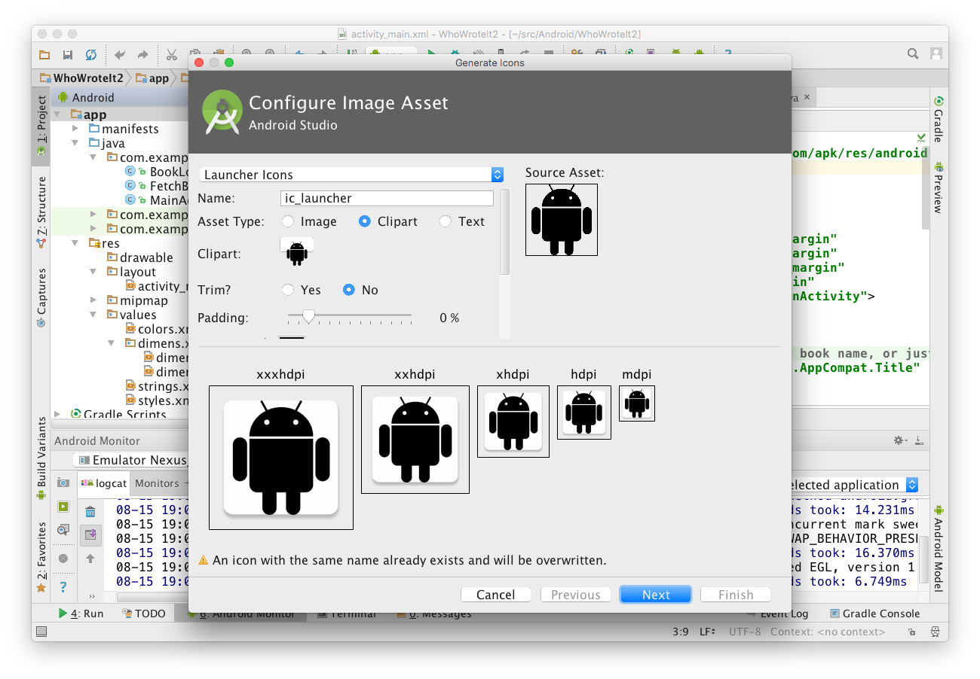
1
2
3
Chose icon typeand change name
Choose Image, Clipart, or Text
Click icon to chose clipart
Inspect assets for multiple screen sizes
4

Slide 48
Vector asset Studio
Notes:
Create one image in xml and it will be able to scale for all different devices.
Create your own app icon

Slide 49
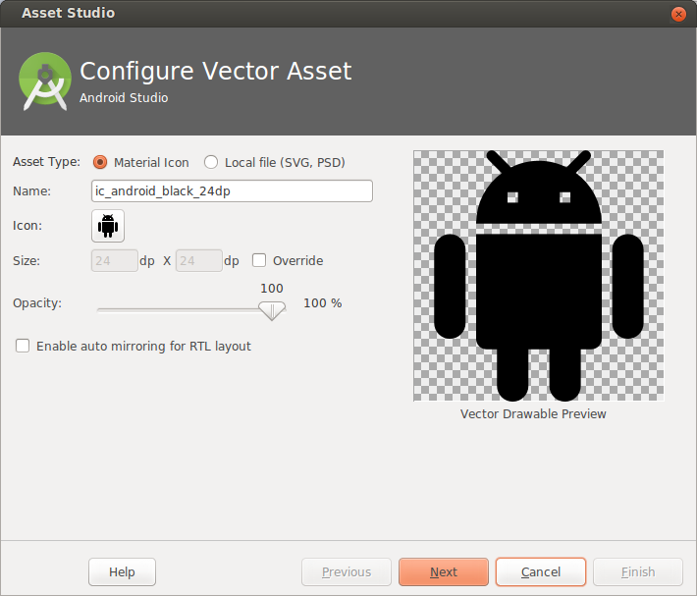
1
2
Choose from Material Icon library, or use your own SVG vector drawing
Opens Material Icon library

Slide 50
Performance
Image downloading and caching library for Android (glide, Picasso)

Slide 51

Layer List example

Slide 52
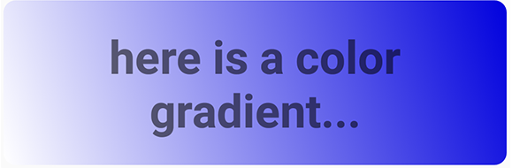
GradientDrawable example

Slide 53
Here's how other smallest width values correspond to typical screen sizes:
320dp: a typical phone screen (240x320 ldpi, 320x480 mdpi, 480x800 hdpi, etc).
480dp: a large phone screen ~5" (480x800 mdpi).
600dp: a 7” tablet (600x1024 mdpi).
720dp: a 10” tablet (720x1280 mdpi, 800x1280 mdpi, etc).

Slide 54
Performance tips
Use smallest resolution
Resize, crop, compress
Vector drawings for simple images
Use Lib: Glide or Picasso
Use lossy image formats and adjust quality where possible

Slide 55
Adaptive layout

Slide 56
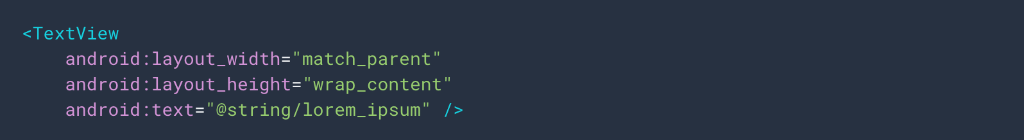

Slide 59
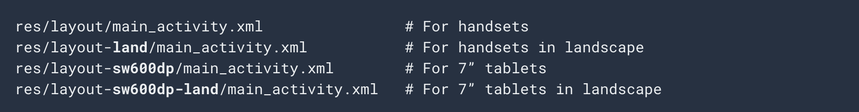

Slide 61
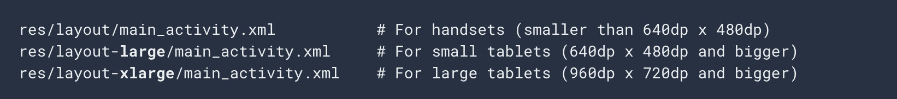

Slide 62
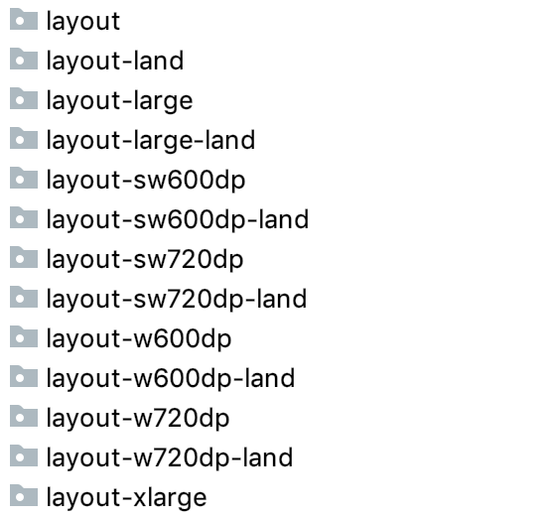

Slide 64
sd = minimum distance between screen edges

Slide 65
d = minimum distance between screen edges

Slide 66
getResources().getConfiguration().screenLayout

Slide 67
getResources().getConfiguration().screenLayout
If (getResources().getConfiguration().screenLayout == Configuration.SCREENLAYOUT_SIZE_LARGE) { // doSomething
}

